Slide 1
Ratings Prediction
SUBMITTED BY
Sachin gupta

Slide 2
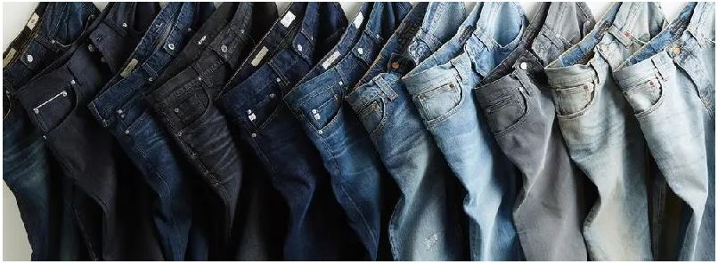

Slide 3
Introduction
Image classification (or Image recognition) is a subdomain of computer vision in which an algorithm looks at an image and assigns it a tag from a collection of predefined tags or categories that it has been trained on.
Vision is responsible for 80-85 percent of our perception of the world, and we, as human beings, trivially perform classification daily on whatever data we come across.
Image classification is the process of categorizing and labeling groups of pixels or vectors within an image based on specific rules. The categorization law can be devised using one or more spectral or textural characteristics. Two general methods of classification are 'supervised' and 'unsupervised'.
Image classification is a complex procedure which relies on different components. Here, some of the presented strategies, issues and additional prospects of image orders are addressed. The primary spotlight will be on cutting edge classification methods which are utilized for enhancing characterization precision.

Slide 4
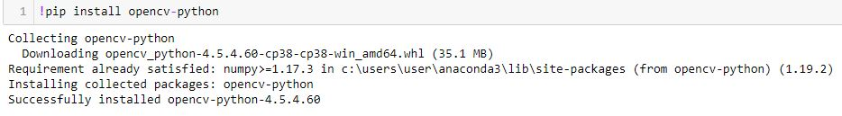
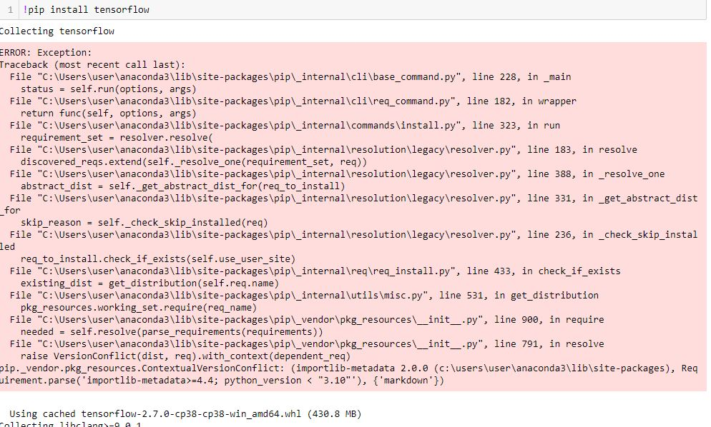
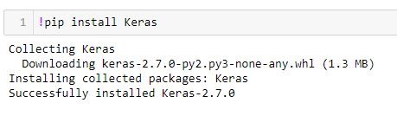
IMPORTING MODULES

Slide 5
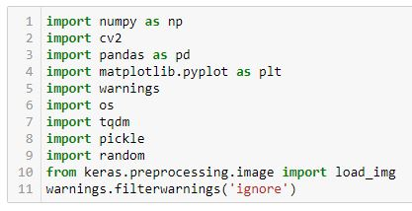
Importing Libraries

Slide 6

Loading dIRECTORY

Slide 7
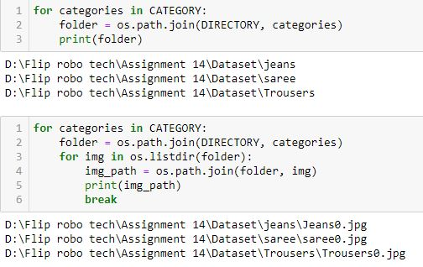

Slide 8
EDA – Exploratory Data Analysis

Slide 9
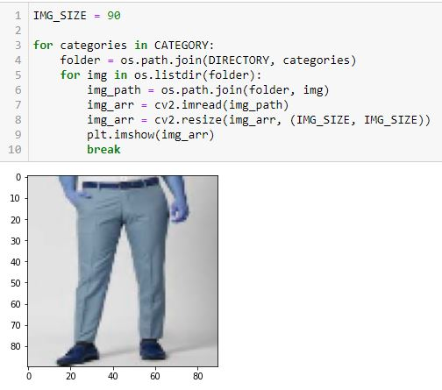

Slide 10
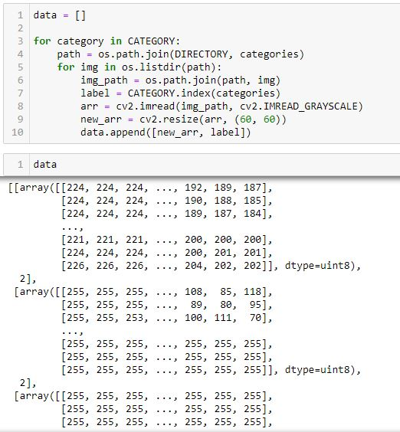

Slide 11

Checking Len

Slide 12
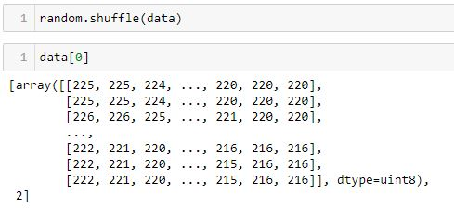
USING SHUFFLE

Slide 13
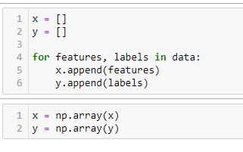
FEATURES & LABELS

Slide 14
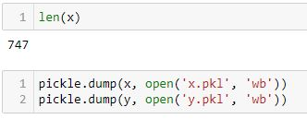
Saving Files

Slide 15
Training Model

Slide 16

